Slide 1
Data Collecting
By Zack Dai

Slide 2
Web Scraping
Web scraping refers to the extraction of data from a website. This information is collected and then exported into a format that is more useful for the user.
Typical Usage:
Product Info
News and Events
Reviews
Articles and Blogs
Social Media

Slide 3
Web Scraping Steps
Find a start page
Analyze website structure
Check URL patterns
Analysis start page Html, CSS structure (Some tools can do it automatically)
Analysis child pages structure
Create a looping process
Choose output file type and data structure
Plan the running time rule, and error handling
Test and debug
Start

Slide 4
HTML Structure

Slide 5
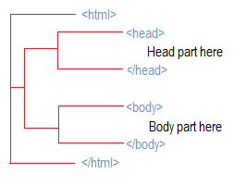
HTML structure
What is a web page?
It is a file in HTML format.
You can see the web page rather than the codes is because you web browser render the code into web page
Understand web structure can save you a lot of time for scraping
Simple Structure

Slide 6

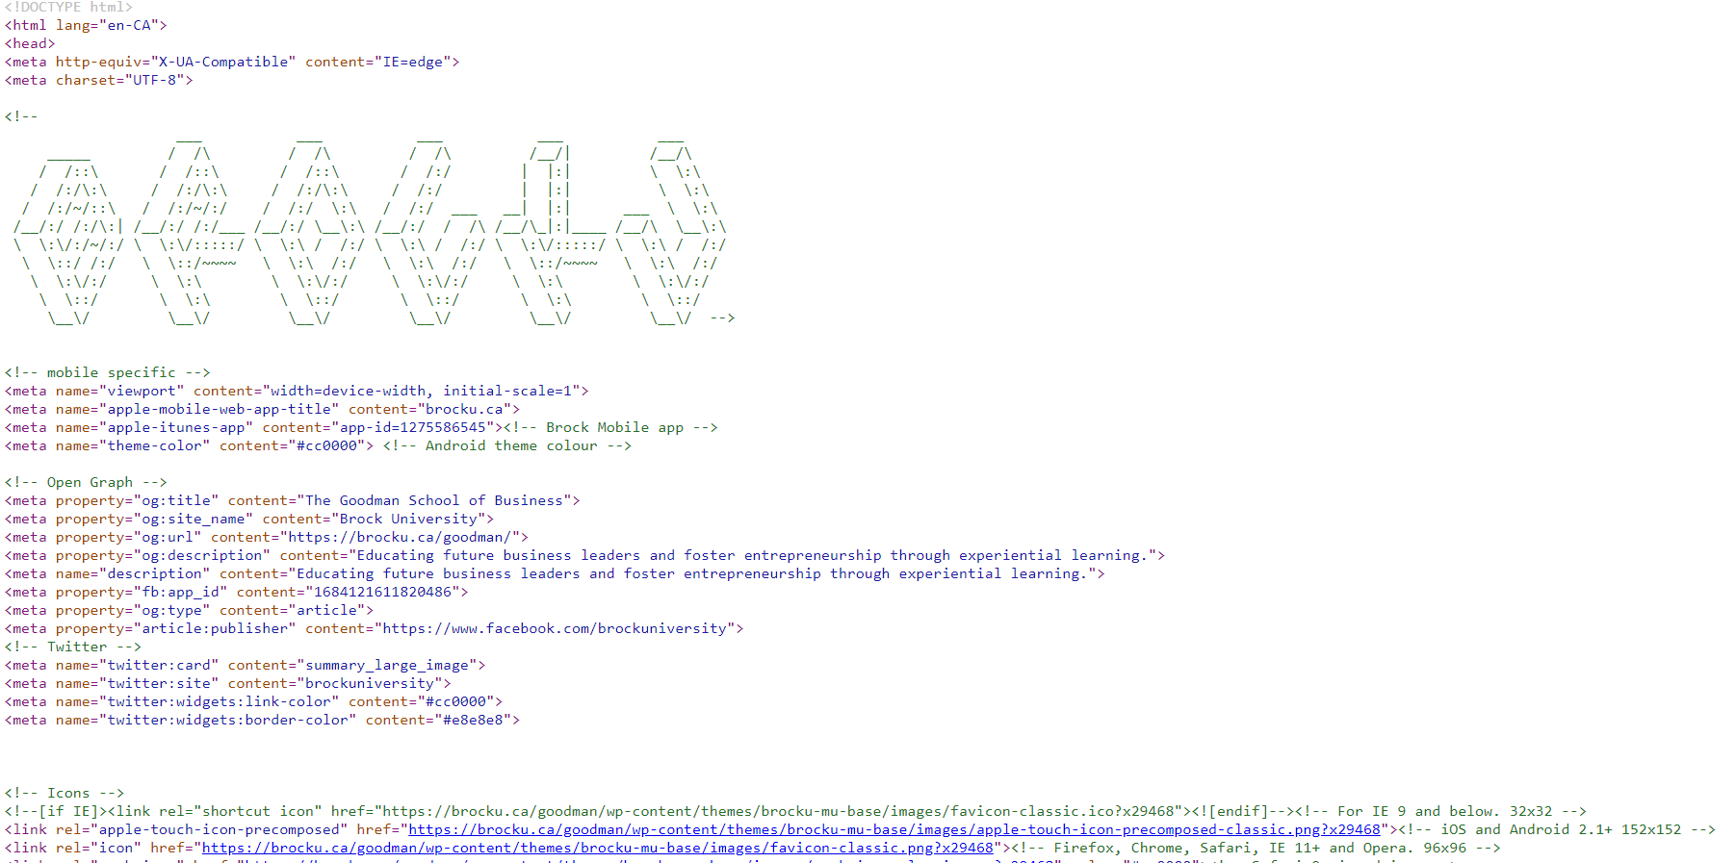
HTML structure
https://brocku.ca/goodman/
view-source:https://brocku.ca/goodman/

Slide 7
HTML structure
Create a simple web page
Open “notepad”
Copy the code on the right, paste to the notepad
Save the file as name ‘home.html’
Open the file with chrome (or double click)
<!DOCTYPE html>
<html lang="en">
<head>
<title>Document</title>
</head>
<body>
<div class='main'>
<h2>Welcome</h2>
<p>This is Brock University Web Scraping Work Shop Home Page</p>
</div>
<div class='list'>
<li>one</li>
<li style="color:red">two</li>
<li>three</li>
</div>
<br>
<div class='link'>
<a href="https://brocku.ca">Go to brock</a>
</div>
</body>
</html>

Slide 8
HTML structure
A HTML is a tree structure file
Basic element is <></> called a tag (<div>visible text here</div>)
One tag can contain many child tags (<div><p>123</p></div>)
Tags can be identified by its attribute (<p class=‘one’></p>)
Tips:
Normally, Similar items have similar tree location and same attribute
The link usually in ‘href’ attribute of <a> tag

Slide 9
Chrome Inspect

Slide 10
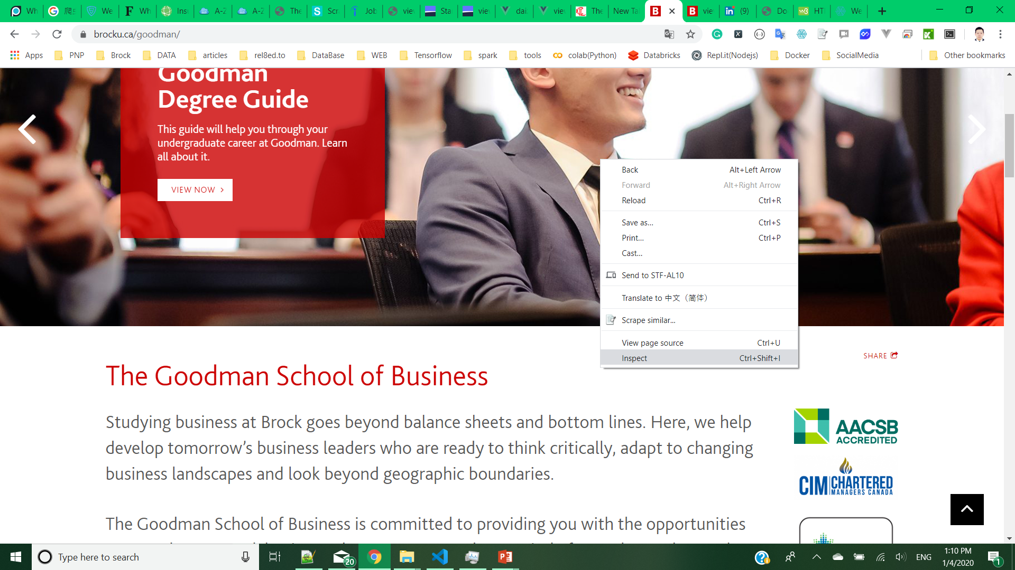
Chrome Inspect
Right click on page, Choose Inspect

Slide 11
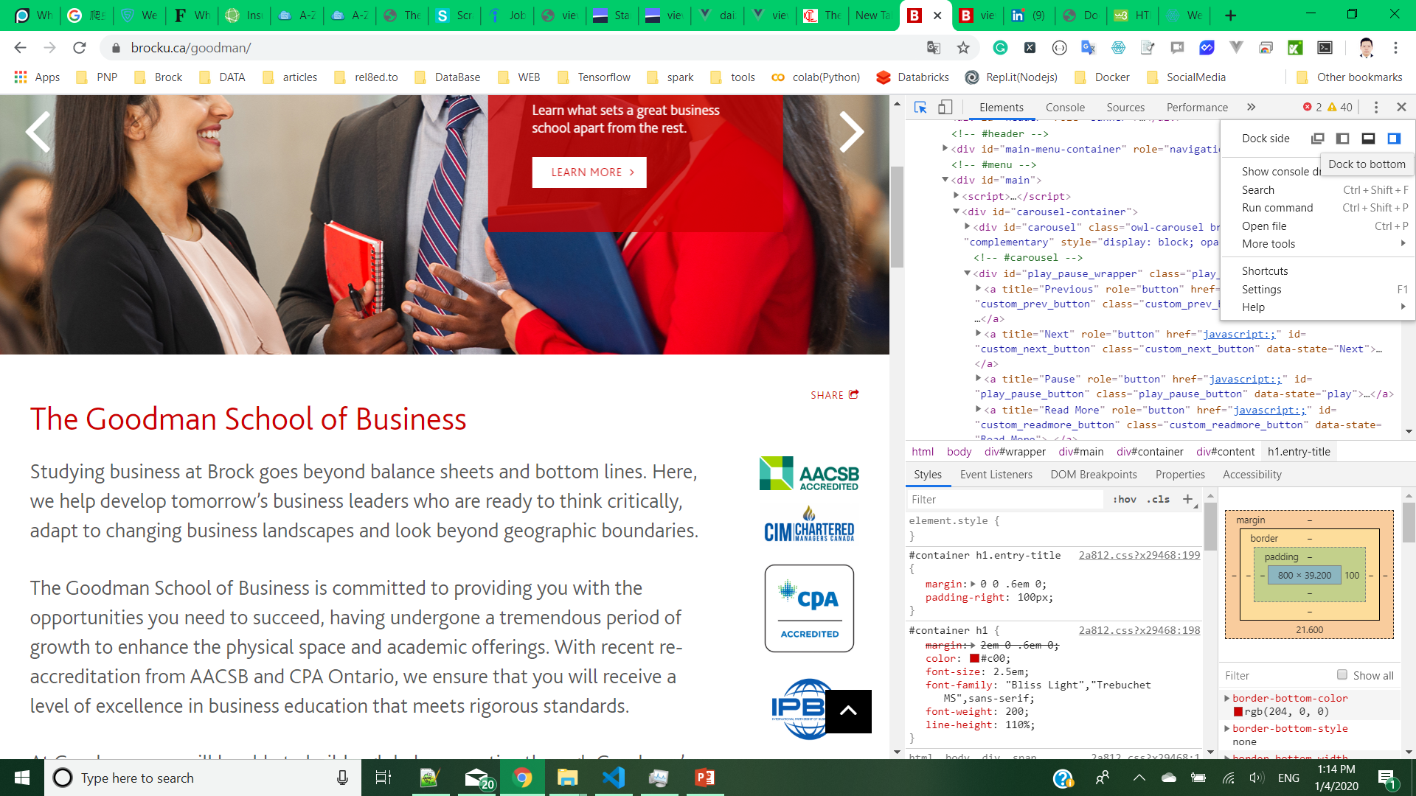

Chrome Inspect
Change Layout

Slide 12
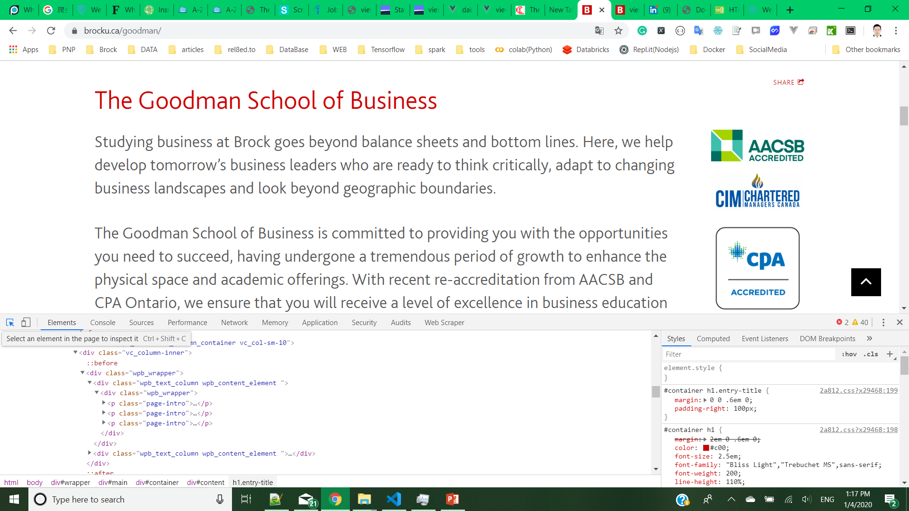
Chrome Inspect
Activate element selection

Slide 13
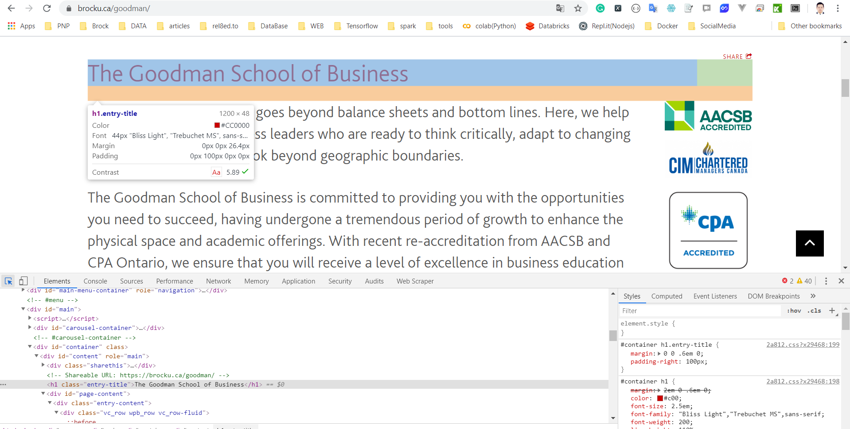
Chrome Inspect
Click the element you want to inspect.
The tag will be shown below

Slide 14
Chrome Web Scraper

Slide 15
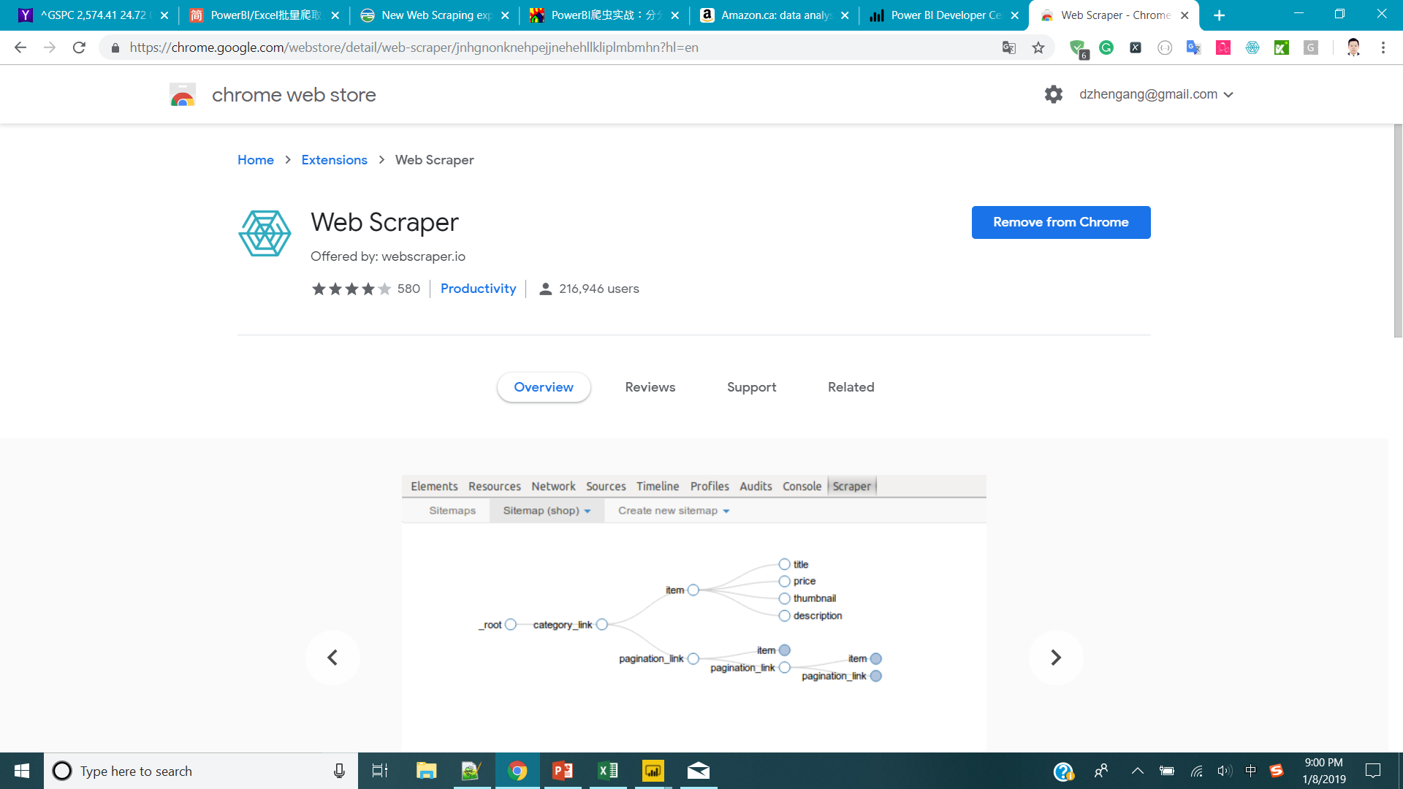
Chrome Web Scraper
Use Chrome Browser Search “Web Scraper - Google Chrome”
Install the extension.

Slide 16
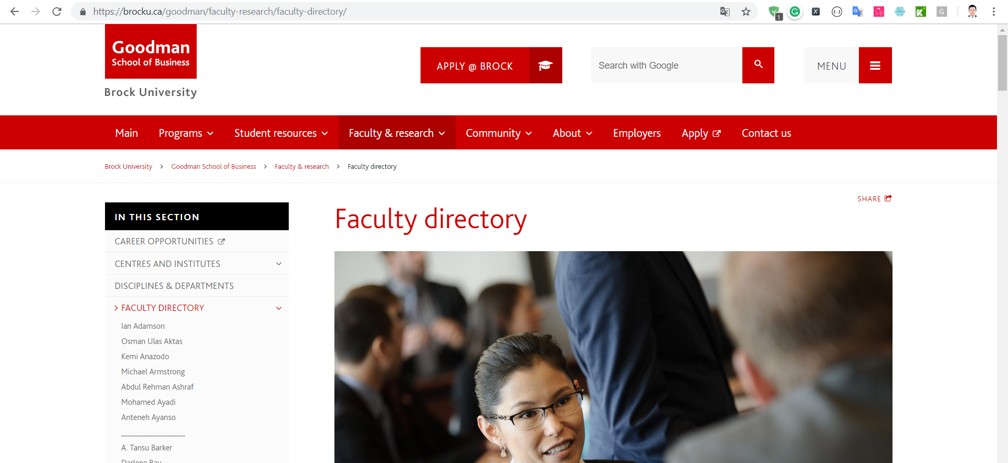
Go to the website you want to crawl
For me:
https://brocku.ca/goodman/faculty-research/faculty-directory/

Slide 17
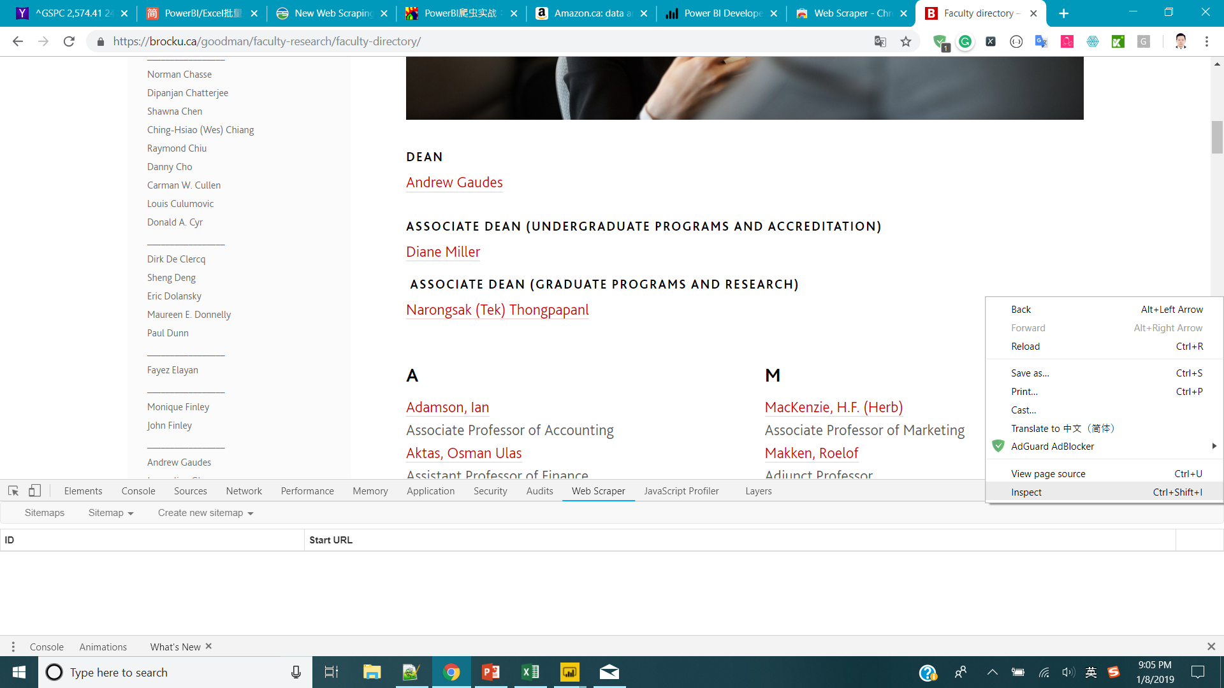
Right click on the page -> inspect
Web Scraper

Slide 18
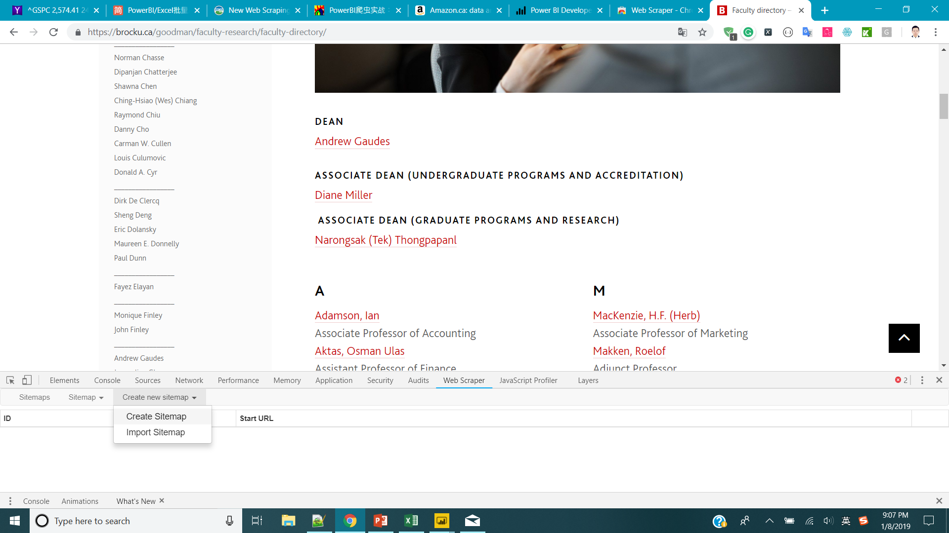
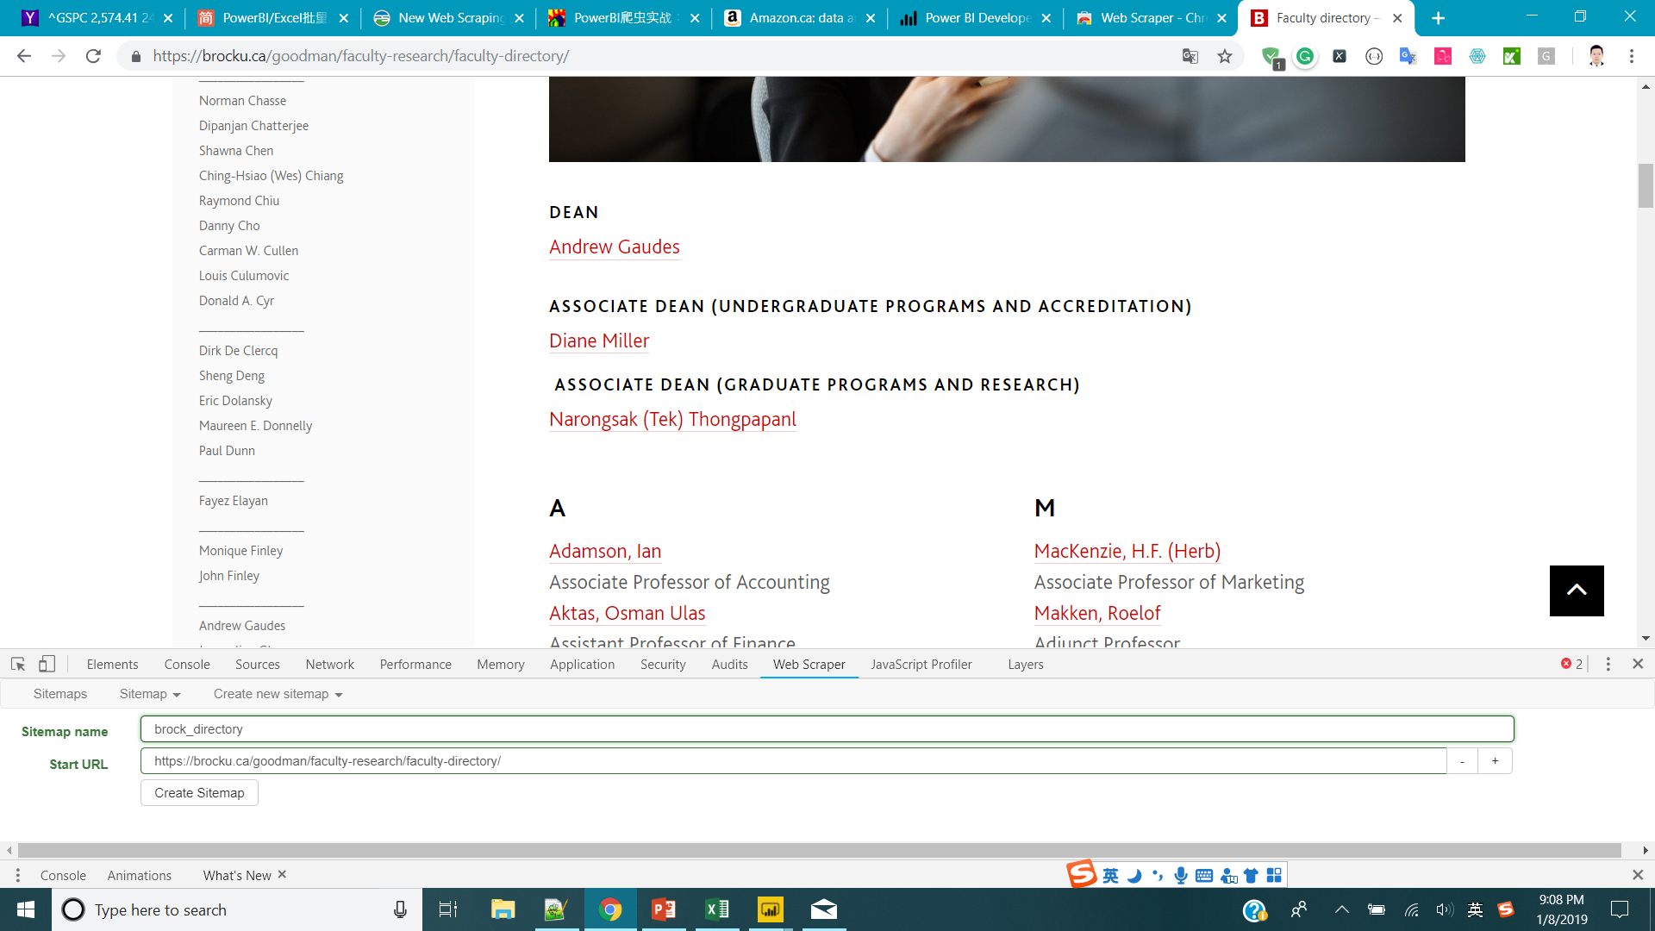
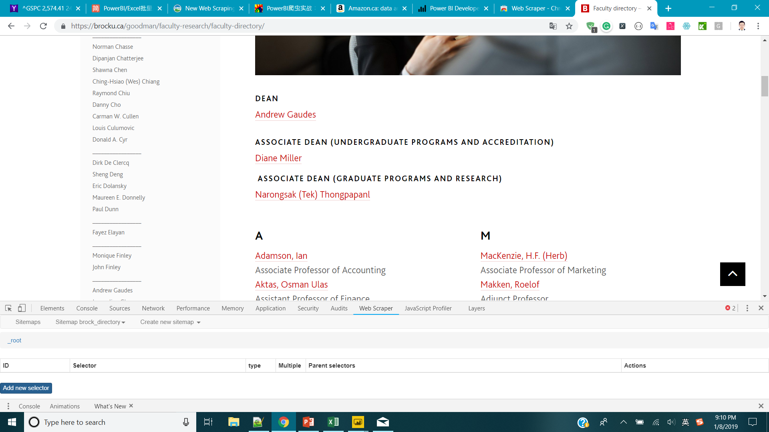
Create Sitemap
Pick a name you like, paste the URL of the webpage
Click Add new selector

Slide 19
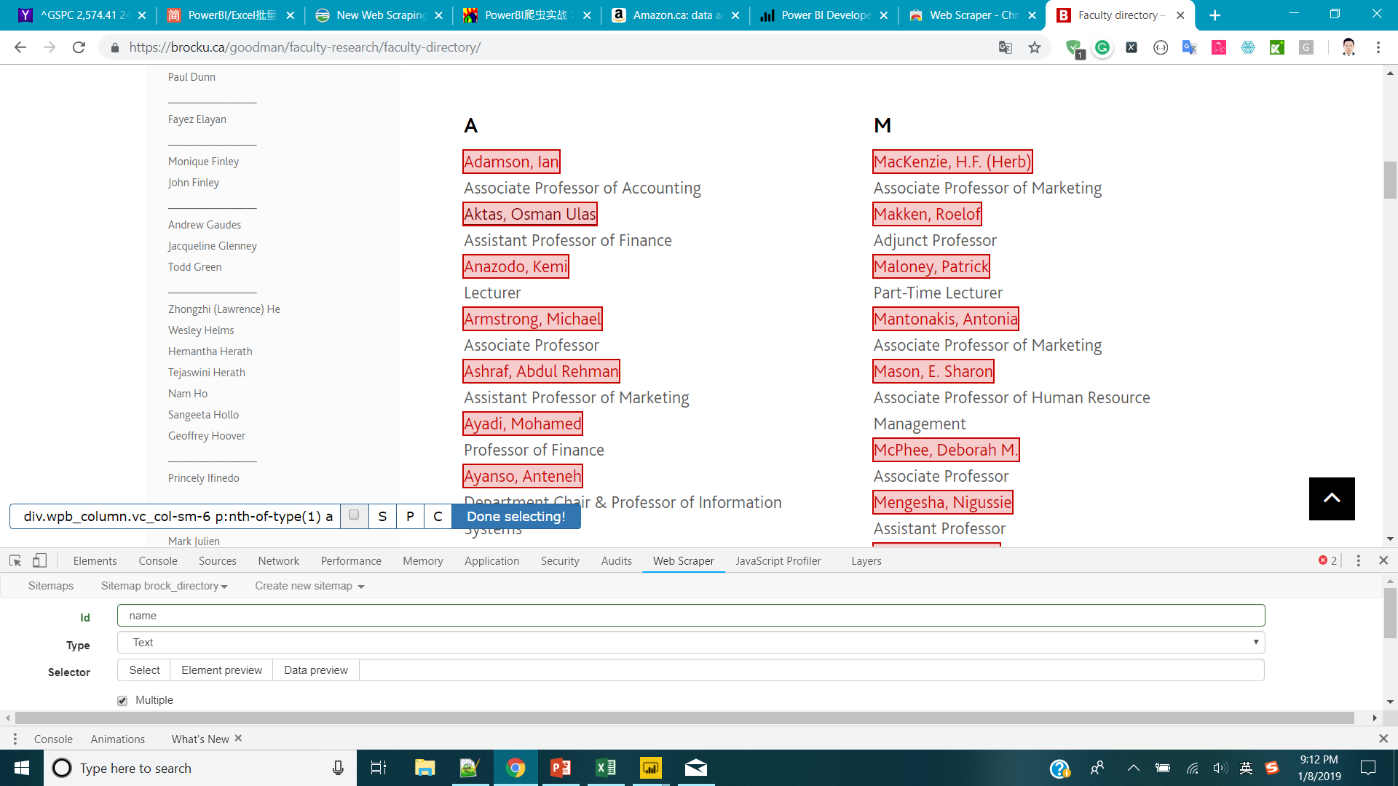
Choose a id, Type: Link, choose Multiple
Choose few professor names it will automatic select. (check the selection)
Done

Slide 20
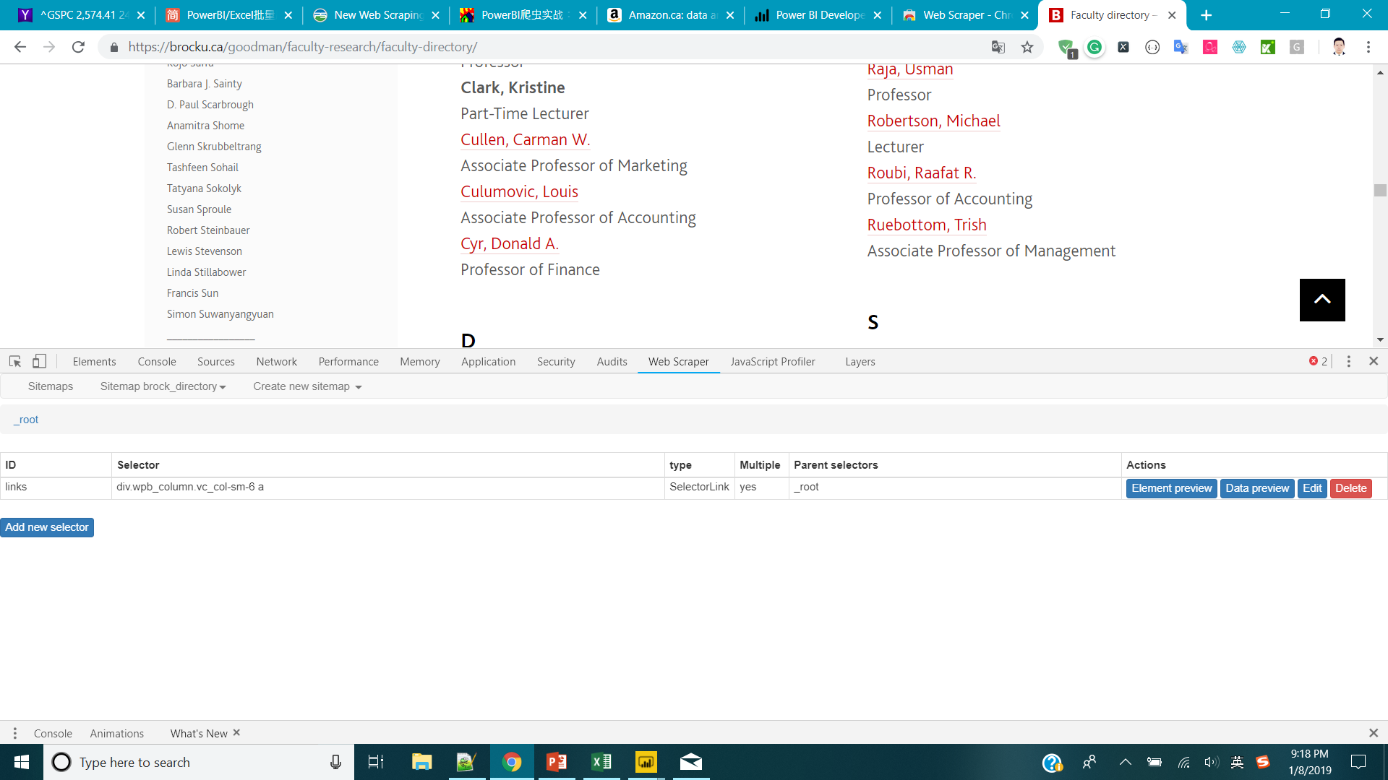
Save selector
Click the selector you created
Go to one of the professor page
Add new selector

Slide 21
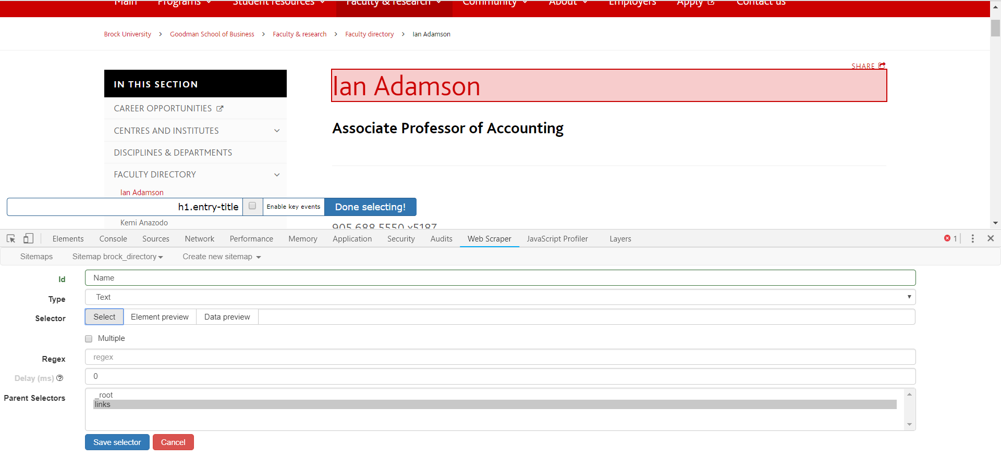
Id: Name
Type: Text
Click the Name of the Professor
Done selecting
Save selector

Slide 22
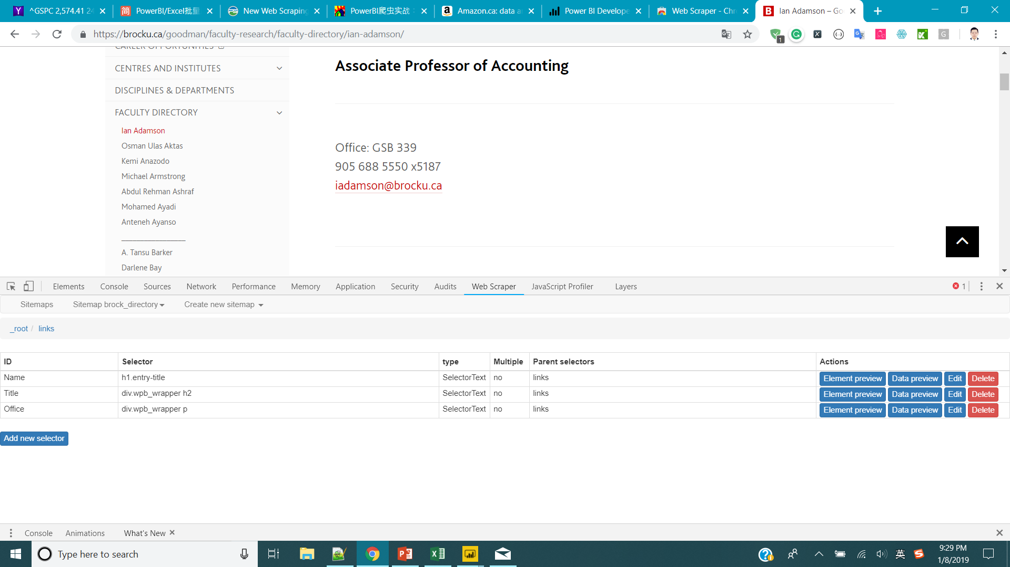
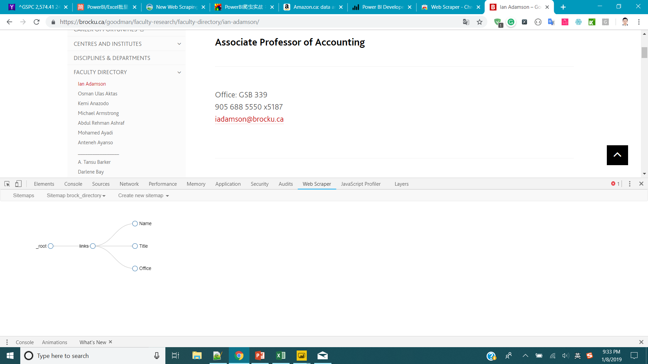

Use the same way to create Title and Office selector
You can check the logic of your scraper by
Sitemap your sitemap name -> Browse

Slide 23

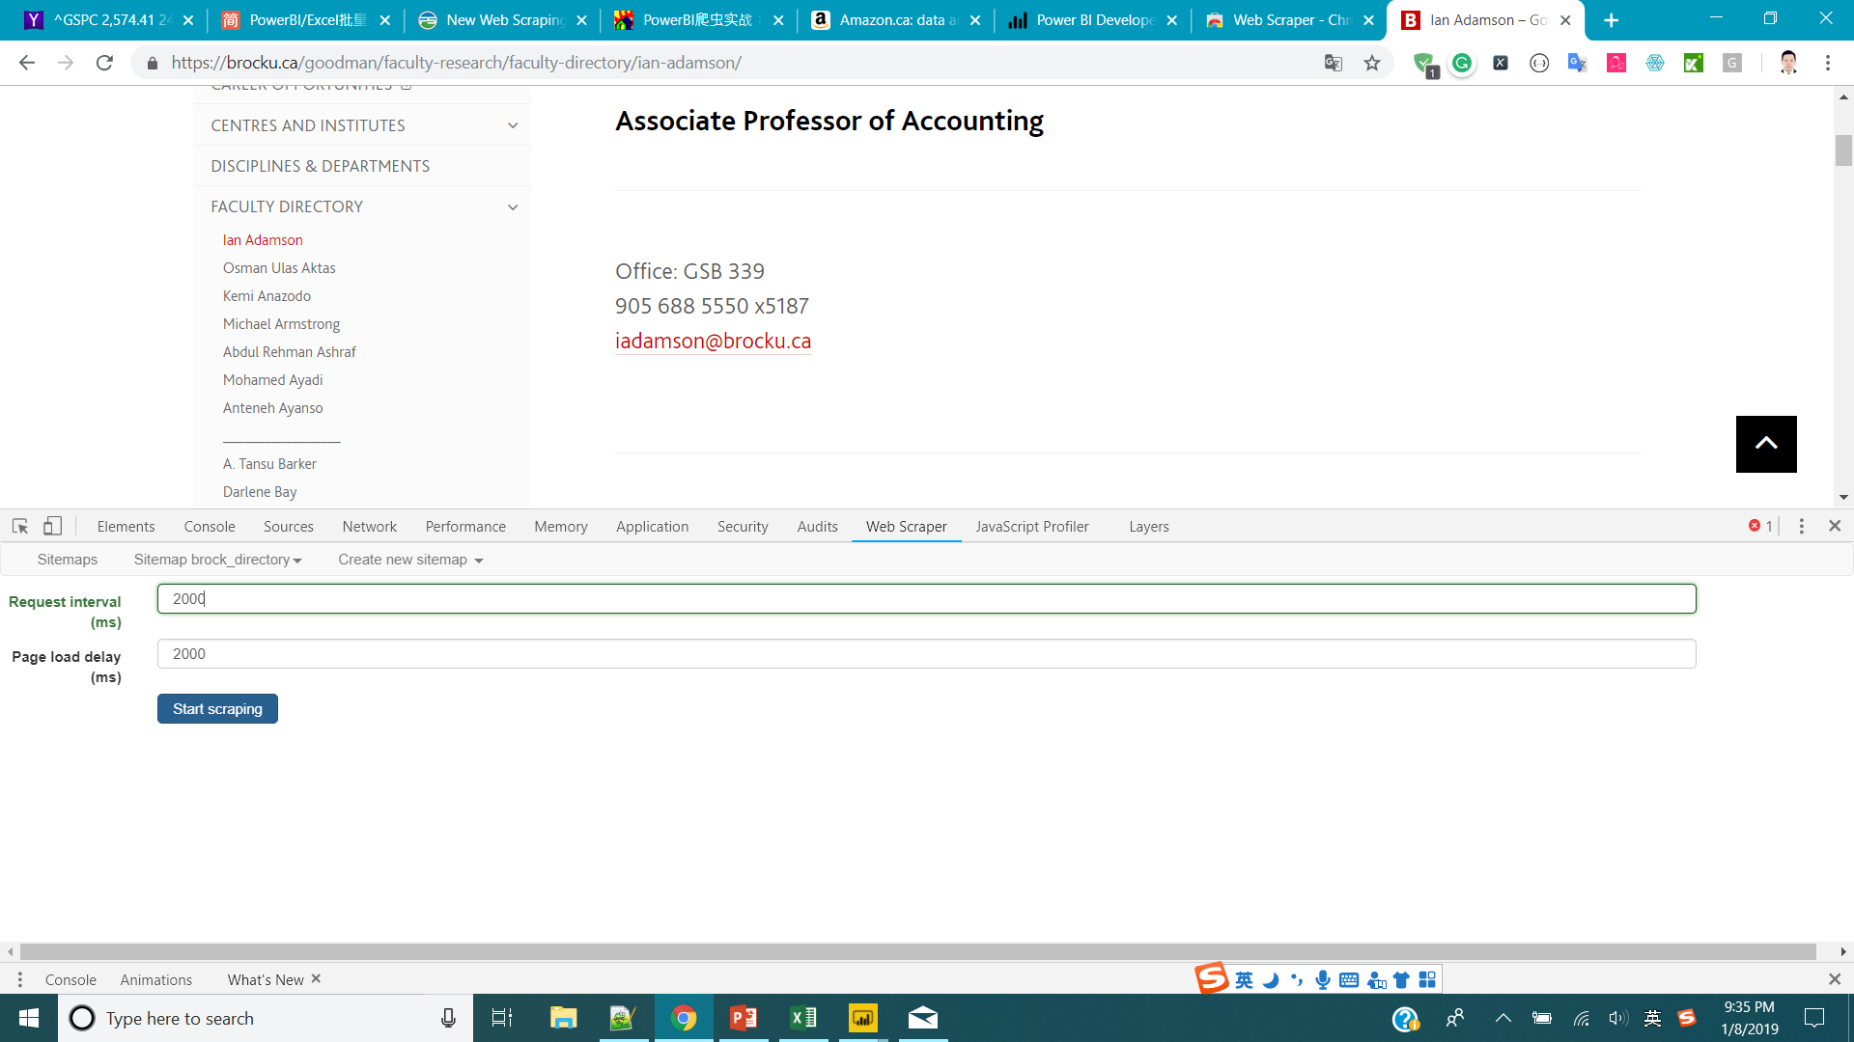
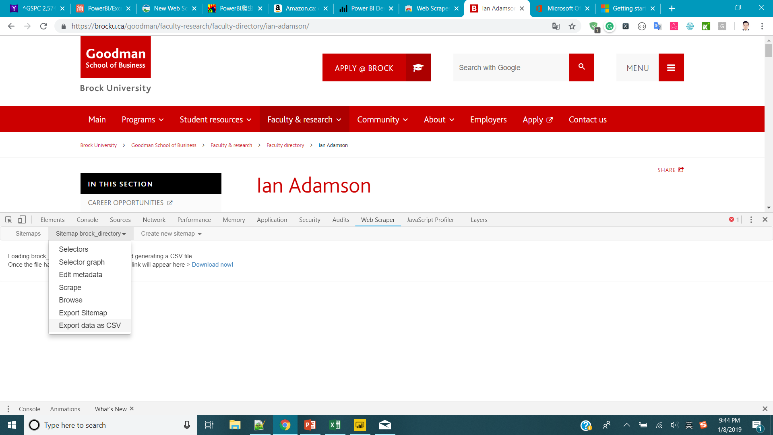
If everything is good go to Scrape, start scraping.
Then just wait till the auto process finish.
Export data as CSV, Download.

Slide 24

Chrome Web Scraper Tutorial Video
https://webscraper.io/tutorials

Slide 25
Octoparse

Slide 26
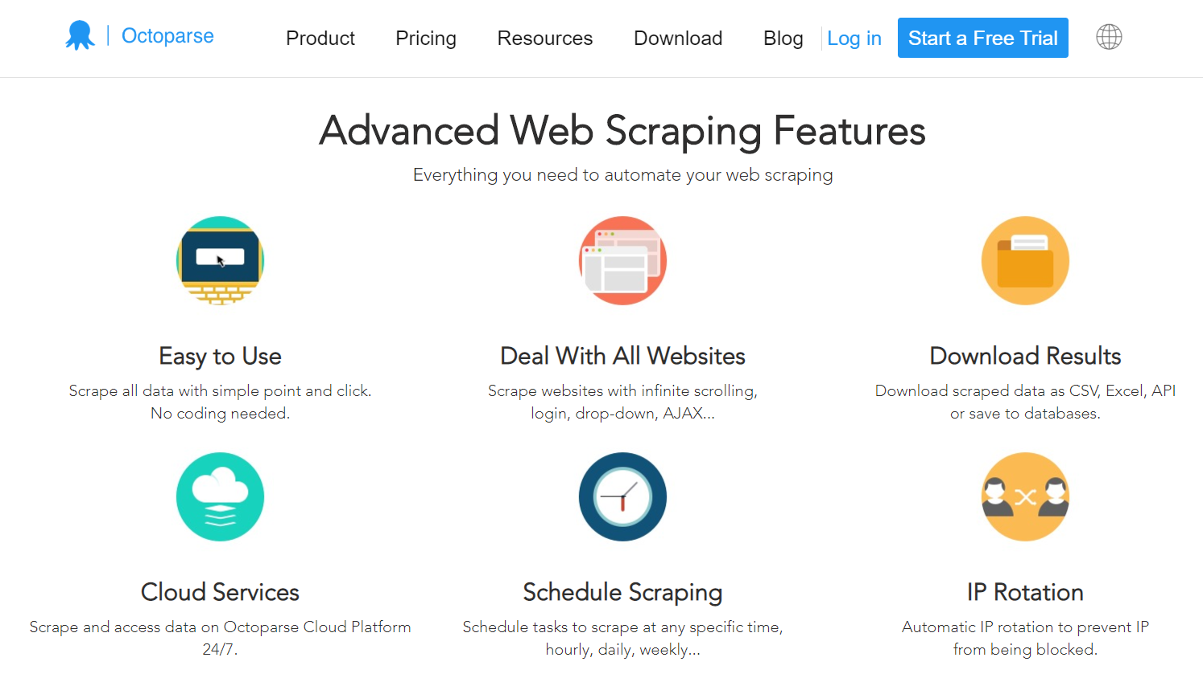
Octoparse
Download Page : https://www.octoparse.com/download

Slide 27
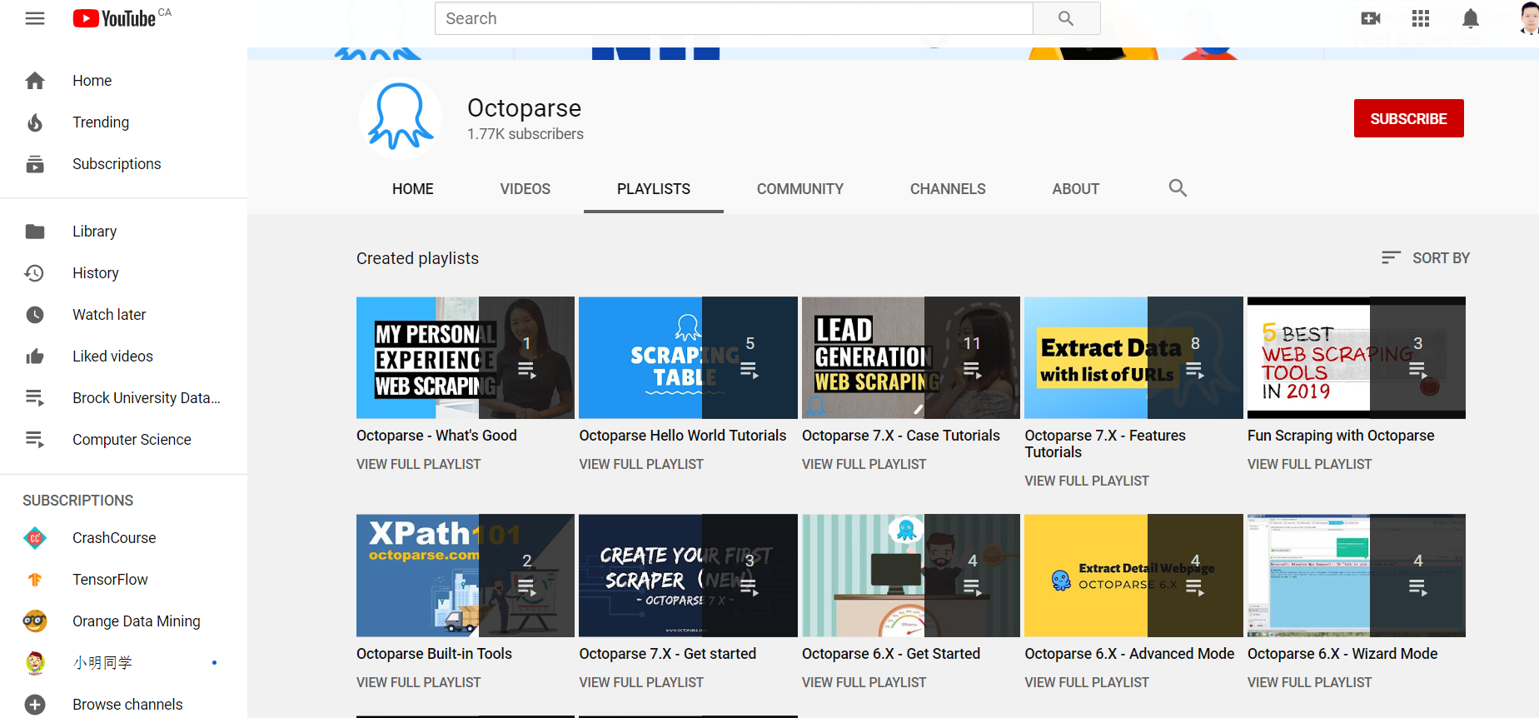
Octoparse Tutorials
https://www.youtube.com/channel/UCweDWm1QY2G67SDAKX7nreg/playlists

Slide 28
University Database

Slide 29
Use University Database
University Database provide large collection of data in different area. If you need exhaustive collect data in some domain, downloading from university library is a very good choice.
Note: You can use Brock University Library after you graduate.

Slide 30
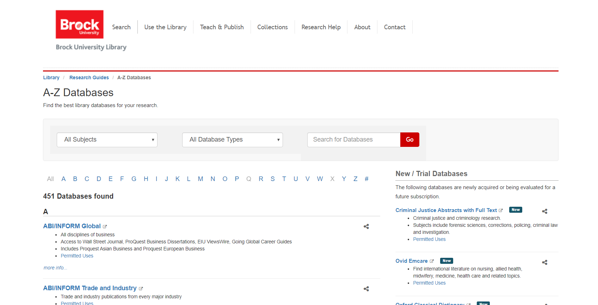
Brock Library Database
https://researchguides.library.brocku.ca/az.php

Slide 31
Appendix: Scraping with Python and Xpath
Step 1: Instore chome extension: “xpath helper” from https://chrome.google.com/webstore/detail/xpath-helper/hgimnogjllphhhkhlmebbmlgjoejdpjl
Step 2: Open target page
https://ca.indeed.com/jobs?q=business+analyst&l=Toronto%2C+ON&start=0

Slide 32
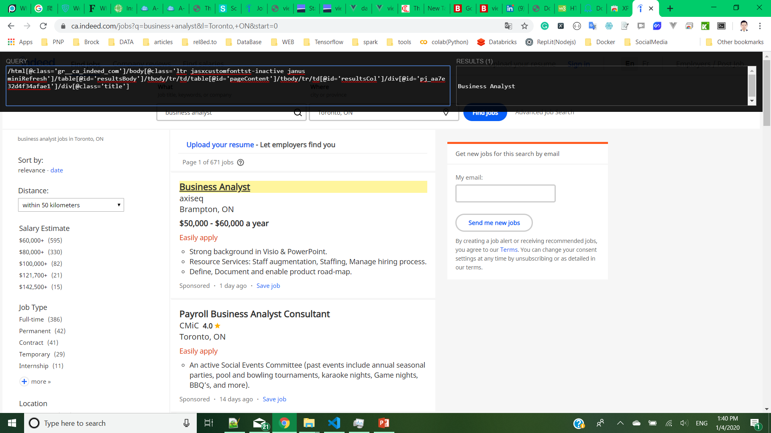
Step 3: Inspect the page with xpathhelper
Click xpathhelper button
Hold “shift” Key and move your mouse to the target item
The path is automatically generated

Slide 33
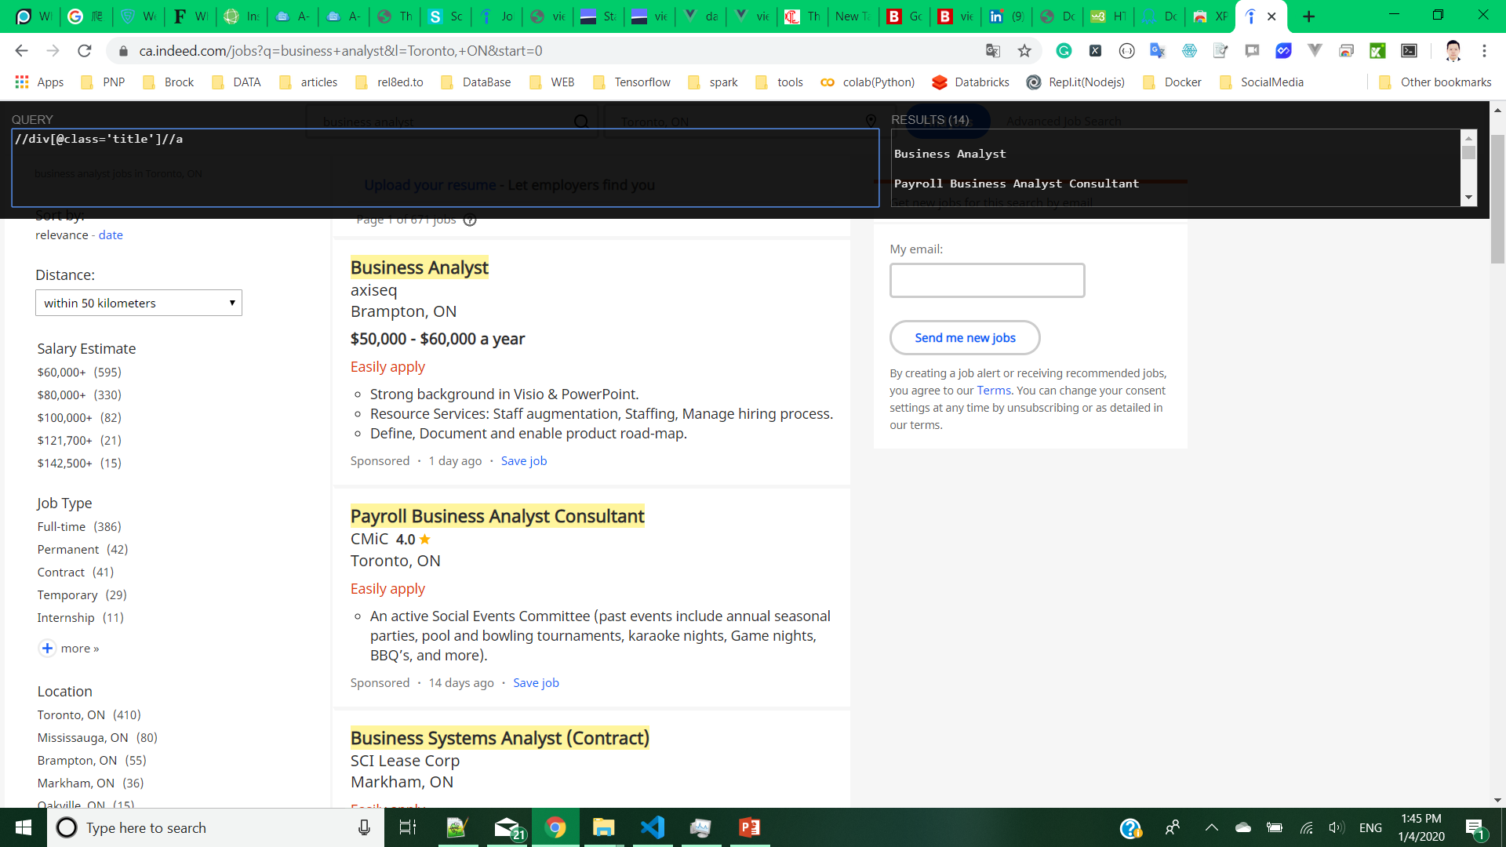
Step 4: Get general path
Analyze the HTML structure, modify the path to get all element selected
In this case the path is
“//div[@class='title']//a/@href”

Slide 34
Step 5 Inspect Child Page
Open a child page https://ca.indeed.com/viewjob?cmp=axiseq&t=Business+Analyst&jk=aa7e32d4f34afae1&sjdu=vQIlM60yK_PwYat7ToXhk0YpwxAsQYrbGk-g50jzcnRMmHBHtBs0ZoNM1Th7GOKmmwcxCdC0GDj4nH2l389bBA&tk=1dtotk5lt0g82000&adid=329561942&pub=4a1b367933fd867b19b072952f68dceb&vjs=3
Use xpath helper to get the paths of the targets
In this case:
Title: “//h3/text()”
Description: “//div[@id='jobDescriptionText’]//text()”

Slide 35
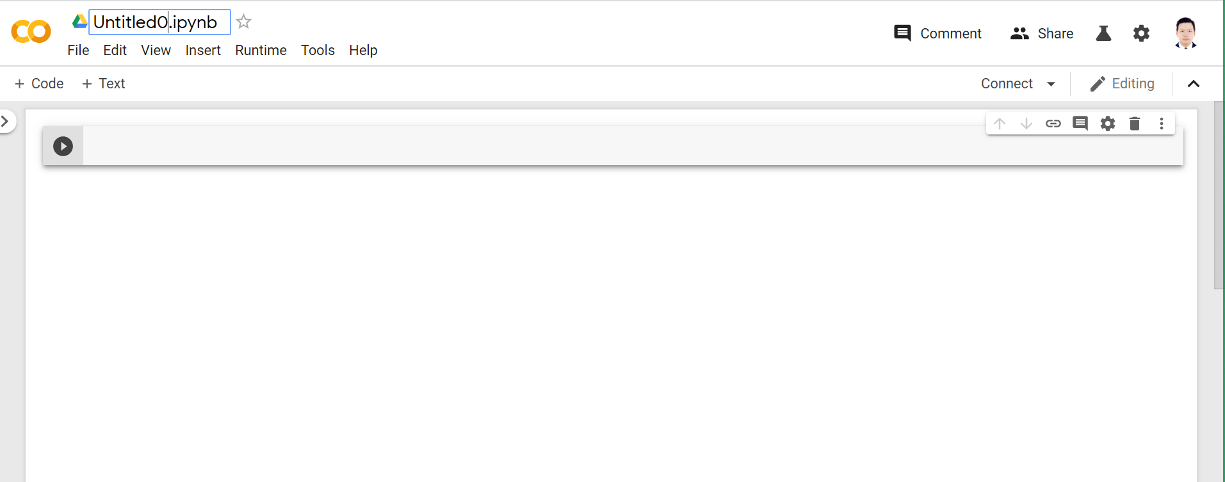
Step 5 Open python or Colab
Google Colab (Recommended): (Need Google Account) https://colab.research.google.com/notebook#create=true&language=python3

Slide 36
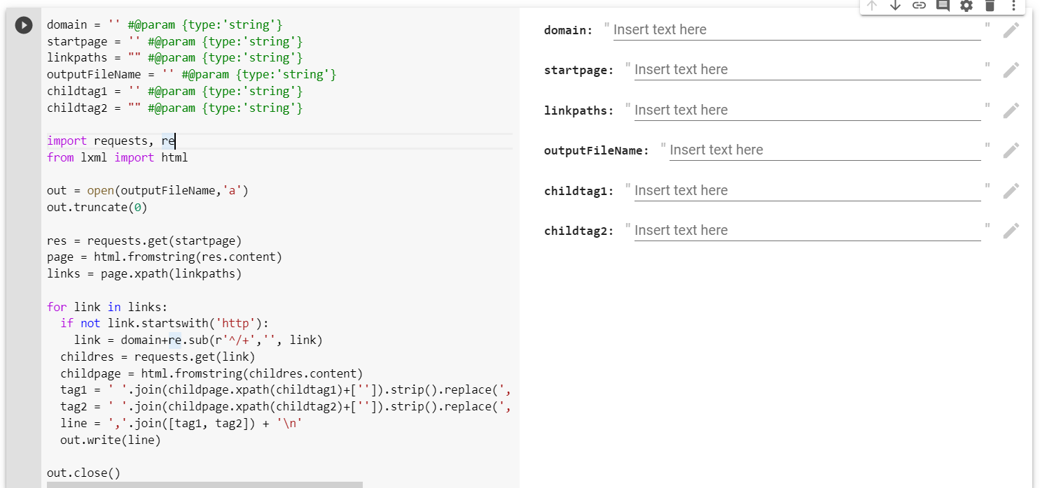
Use the code below
domain = '' #@param {type:'string'}
startpage0 = '' #@param {type:'string'}
linkpaths = "" #@param {type:'string'}
outputFileName = '' #@param {type:'string'}
childtag1 = "" #@param {type:'string'}
childtag2 = "" #@param {type:'string'}
childtag3 = "" #@param {type:'string'}
maxpage = #@param {type:'integer'}
import requests, re
from lxml import html
out = open(outputFileName,'a')
out.truncate(0)
for pagenum in range(1,maxpage+1):
if maxpage == 0:
pagenum = ''
startpage = startpage0 + str(pagenum)
res = requests.get(startpage)
page = html.fromstring(res.content)
links = page.xpath(linkpaths)
for link in links:
try:
if not link.startswith('http'):
link = domain+re.sub(r'^/+','', link)
print(link)
childres = requests.get(link)
childpage = html.fromstring(childres.content)
tag1 = ' '.join(childpage.xpath(childtag1)+['']).strip().replace(',', ' ').replace('\n',' ')
tag2 = ' '.join(childpage.xpath(childtag2)+['']).strip().replace(',',' ').replace('\n',' ')
tag3 = ' '.join(childpage.xpath(childtag3)+['']).strip().replace(',',' ').replace('\n',' ')
line = ','.join([tag1, tag2, tag3]) + '\n'
print(line[:50])
out.write(line)
except Exception as e:
print(e)
continue
out.close()
Paste the code on the right to your Colab cell

Slide 37
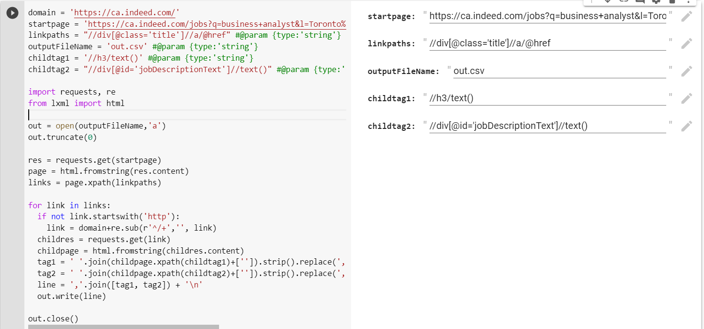
Step 7: Run code
Fill the Parameters you get from previous Steps
Run the Cell

Slide 38
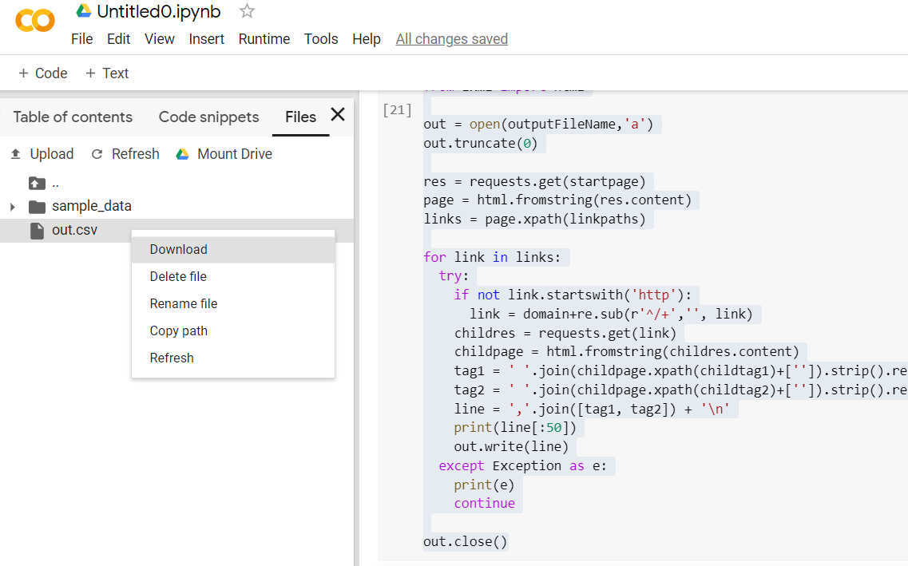
Download Your Result

Slide 39
Home Work
Scrape Ontario Job Posting from Ontario Government Website
https://www.on.jobbank.gc.ca/jobsearch/jobsearch?searchstring=&fprov=ON
Requirement:
Get at least 100 job positings
Get Job Title, location, and Advertised until Data for those jobs

